Slide 1
BUILDING CAPACITY
THE NEXT STEPS

Slide 2
REFRESHER WHERE WE HAVE BEEN?
Prioritizing Standards – Where will we be first placing our focus?
Unpacking Standards – Do we have a deep understanding of the intent of each standard?
Notes:
What you can say: This is just a quick reminder of where we have been...

Slide 3
MOVING FORWARD WHAT COMES NEXT?
Assessment Adjustments – Modify both formative and summative assessments to meet the standards. Ensure assessments are appropriately designed.
Instructional Shifts – Alter instruction as necessary to better meet the standards and practices.
Notes:
What you can say: ...and this is where we are going. These really go hand-in-hand. Actually, we have the four parts of education working together in this process, don’t we? Standards, Curriculum, Assessment, and Instruction. We have addressed Standards through the prioritizing and unpacking. Districts use those adjustments to develop the curriculum. So now we want to lay out some ideas for the assessments… which often help us make instructional shifts.

Slide 4
ASSESSMENT
Understanding and Development
of Formative Assessments
Notes:
What you can say: So let’s dig into it.

Slide 5
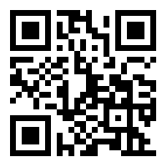
WHAT ARE THREE WORDS THAT COME TO MIND WHEN YOU THINK ABOUT FORMATIVE ASSESSMENT?
3
Go to:
http://tiny.cc/TVF2020
OR
2
WORDS
MINUTES
Notes:
What you can say: Capitals and lowercase letters matter on the tiny url address. Original url is https://www.menti.com/iauc1y9thk

Slide 6
Why Assess?
Chapter 2 from Larry Ainsworth’s Common Formative Assessments
What to Read
Everyone: The Need for...
1s: The Rationale... (except the paragraph after the bullets)
2s: Foundations of...
3s: Formative Assessment...
Follow Four A’s Text Protocol
Read – alone -- first
Make notes – alone – while reading
THEN have the discussion at your table following the protocol
Notes:
<EQ -- WHY assess?>
What you can say: Remove the following from your folder:
Four A’s Text Protocol
Four A’s Text Protocol Note Sheet
Text – Assessment Literacy 2.0
Take a moment to review the text protocol and the note sheet. <Give 3-4 minutes for this, then review for clarity>
Rather then have everyone read the whole piece, we are going to section it off. At your tables, count off 1, 2, 3, 1, 2, 3, etc... <Click> Everyone will read the first part of the article, and then... <run through of reading sections>
<Click> Read your section of the text on your own and make notes on the Four A’s Note Sheet accordingly. When everyone at your table is finished, follow the protocol through step 3. We will give you about 20 minutes total for this.
<Walk about and listen in on conversations. When they have moved through the protocol, bring participants back together as a whole group and have a discussion – based on their reading and conversations, “Why Assess?”>

Slide 7
Formative Assessments
Can be classroom specific
Often planned, but can be developed on the fly if necessary
Information gathered is generally used within 24 hours
Should NOT go into the “gradebook”
Common Formative Assessments
Common to all those who teach what you teach
Carefully planned and discussed
Information gathered is used in a timely fashion
Should NOT go into the “gradebook”
Checks For Understanding
Notes:
Review this, then...
What you can say:
When talking about Common Formative Assessments: Although these are carefully crafted assessments, they are not intended to be summative. That is, they should not be used as a tool to provide final grades. Instead, they should be used as a tool to identify what can be done to improve those final grades.
When talking about Common Formative Assessments: Better if developed in advance – This gives us a chance to really develop a focused question or assessment structure. That said, sometimes these need to be developed on the fly.
Turn to a neighbor: What might be used as a CFA in your school? What are some CFUs that you know or use?
Share The key here is this... Our focus today will be on Common Formative Assessments. However, the ideas and tools that we provide can be used for Checks for understanding as well. <Click to next slide>

Slide 8
Types of Questions We’ll Address
Mostly Multiple Choice
A Little Constructed Response
Notes:
What you can say: Because of the way that a large majority of CFAs are created we will primarily focus on Multiple Choice questions today. Again, though, the materials we provide you will certainly help with the development of Constructed Response tasks.

Slide 9
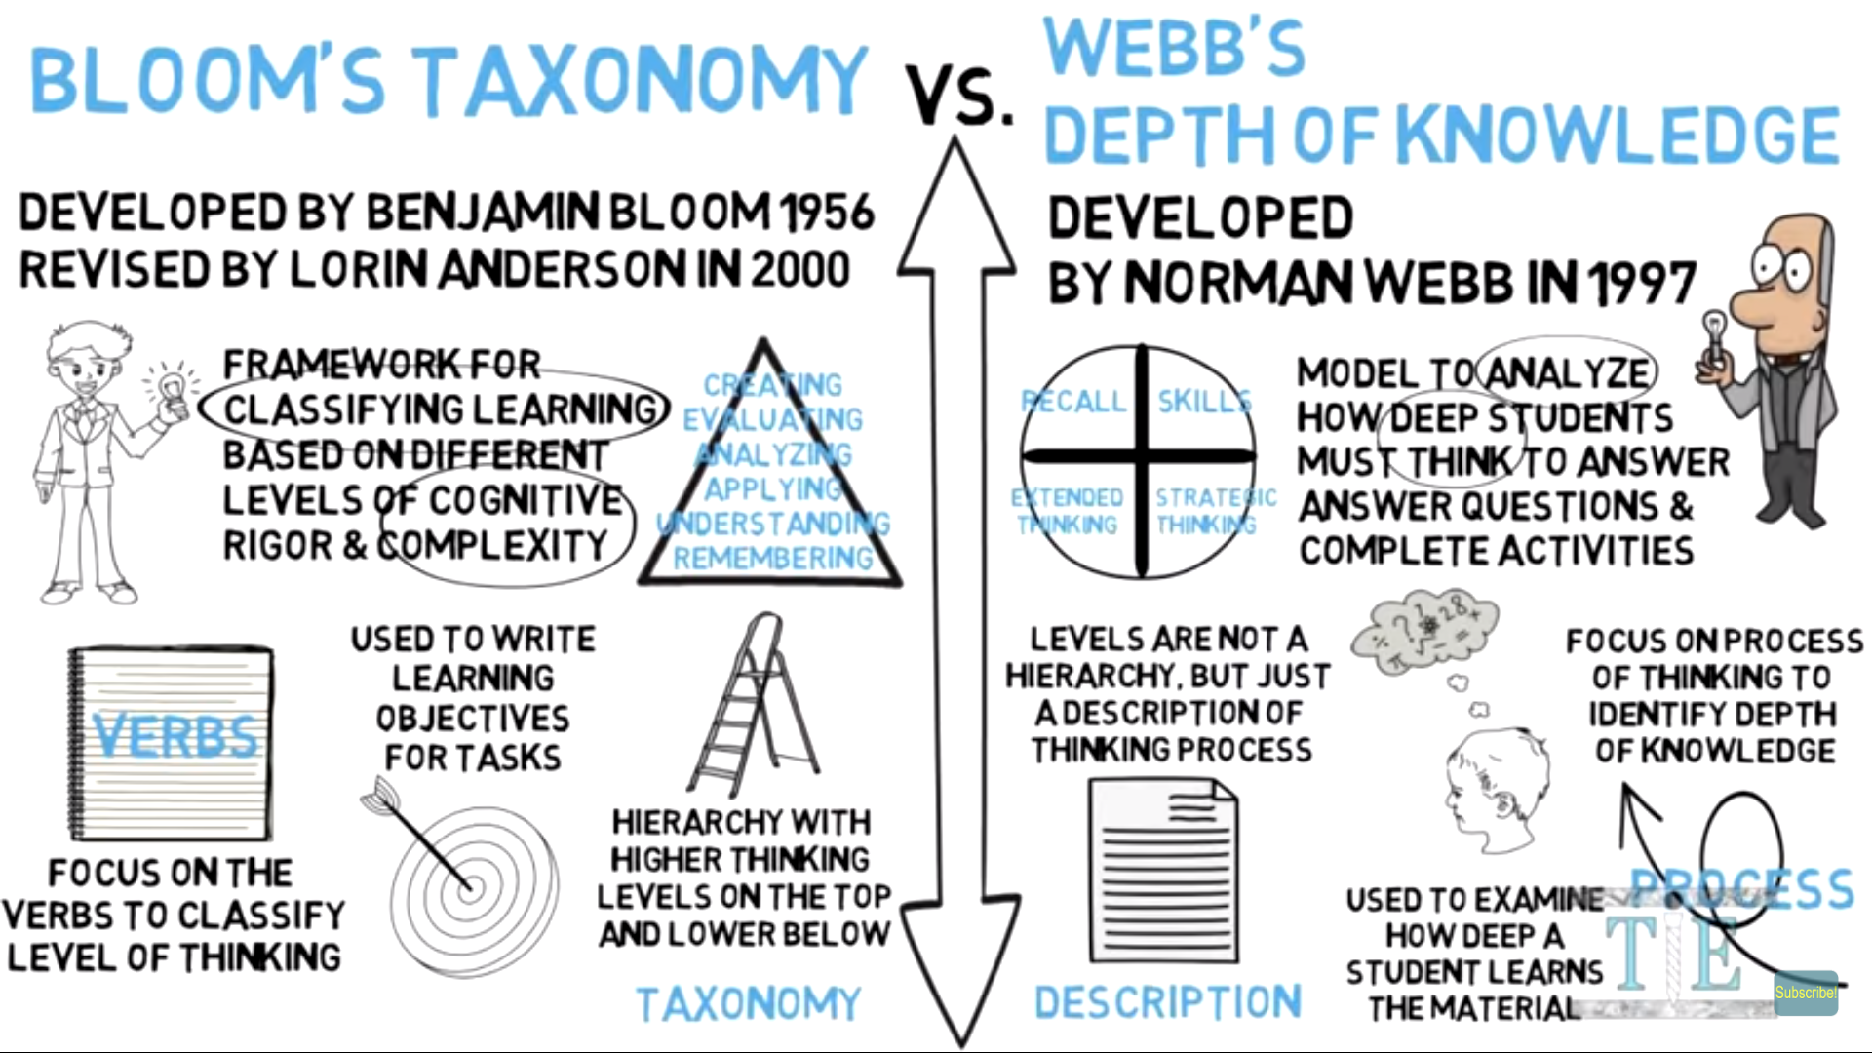
✓ Why Assess?
How Might Webb’s Depth of Knowledge Help Us Calculate Cognitive Demand in Multiple Choice Questions?
Notes:
What you can say: To begin, let’s explore how we find and develop value in multiple choice questions using Webb’s Depth of Knowledge structure. <Ask for raised hands... Who is familiar with Webb’s DOK... Assure them that it is okay if they aren’t)
Often, Webb’s Depth of Knowledge is seen as simply a different version of Bloom’s Taxonomy, and we can use Bloom to help us understand it, but they are two very different things. We are going to show you a quick video clip to help you begin to understand (or refresh your thinking) on Webb’s DOK. As you watch this, keep this question in mind: How Might Webb’s Depth of Knowledge Help Us Calculate Cognitive Demand in Multiple Choice Questions?
<Click to start movie>
If movie does not work, it can be found here: https://youtu.be/P_0kJcxJxI8
Using Webb’s DOK to Calculate Cognitive Depth in a Multiple Choice Question

Slide 10
Notes:
After video ends, ask participants to pull out brightly colored “Levels of Thinking in Bloom’s Taxonomy and Webb’s Depth of Knowledge” page.
What you can say: There are good and bad parts to this document. Take a moment to look it over. <Then...> Please note that the VERBS under the Webb concepts are POTENTIAL CONNECTIONS to ideas in Bloom’s taxonomy. No more than that... When we are talking about the DOK (Webb’s Depth of Knowledge), please remember that we are looking at descriptors. Those descriptors have verbs in them (obviously), and often you will find a verb that seems common to a section of the DOK. That does NOT mean, though, that every time you see that verb, it falls into a specific category. Again... Look at the descriptors.
<Click>

Slide 11
Digging Deeper into Webb
Read to develop a deeper understanding of DOK categories
! This is important ? I have a question about this  I want to dig deeper into this
Discuss your thoughts and findings with the people at your table
Notes:
What you can say: The next set of pages in your folder was adapted from Webb’s work by Amy Lamitie at OHM BOCES. We are going to give you some time to read through these documents. Note that the first page is general, then Math, then Reading, then Writing... With examples for each. Mark this text up as you are reading... Then have a discussion with those at your table. Use these pages to begin to dig deeply into Webb’ DOK.
<Distribute sample question envelopes while they are working>

Slide 12
Calculating Cognitive Depth in a Multiple Choice Question
Work in groups of three (or so)
Identify questions as
1. Recall
2. Skills
3. Strategic Thinking
4. Extended Thinking
When done, compare and discuss with a neighboring group
Notes:
What you can say: Use the video, chart, the reading and... The Hess documents found in your folders ... to sort through the cards in the envelopes on your table. <Point out the Assessment Items Sort Directions in their folders. (J– skipping bullet three in favor of checking in with neighbors) Work together to figure out which are Recall, Skills, Strategic Thinking, and Extended Thinking. When you have yours sorted, check in with some neighbors... Do your answers agree? If not why not?
<Then, distribute second envelope to groups so that they can check their answers> Here are our thoughts... Take a few minutes to compare.
<Discussion> Let’s be clear... An Extended Thinking question is not inherently better than a Recall question. It’s just that they each serve a different purpose. So when developing or revamping Common Formative Assessments to match the changes in the standards, please keep this in mind! If, for example, you are developing the questions for a small quiz on a topic that you are just beginning to teach, it may be mostly Recall and Skills. That said, by the time we reach most “Common Formative Assessments” – i.e., assessments that we are going to spend significant time working together to develop – it would be reasonable to assume that we are looking for some deeper thinking from the students. Moreover, if you look at the state assessments, you will notice that they have moved from “know stuff” questions to “know stuff and be able to do something with what you know” questions. Therefore, you will probably be developing more Strategic Thinking and Extended Thinking questions.
IMPORTANT TO NOTE – We mentioned that there would be some reference to Constructed Response questions. Here it is: “You can use Webb’s DOK to help plan those questions as well!” They all follow the same basic principles: What standard (or part of a standard) is being assessed? To what level do I want to assess it?
So... we have spent some time digging in to WHY we assess and we have looked at a structure that we can use to help us identify the level of cognitive depth we are requiring from the students.
The next step is looking more closely at the incorrect answers we use in a multiple choice question...<Click>

Slide 13
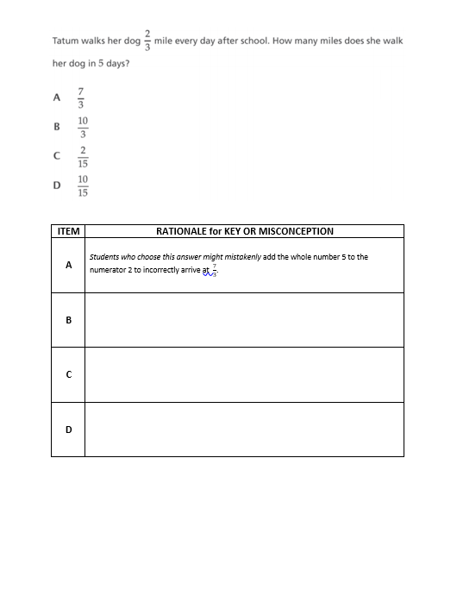
Distracters
Should connect to potential student answers
Help us determine student misconceptions and procedural errors.
Notes:
What can a student’s multiple-choice answer selection tell me about their learning?
What you can say: We aren’t going to spend a great deal of time on this, because it doesn’t take long to learn... However, it can take some serious time to implement. Every multiple choice question has a right or best answer. However, the wrong answers, if carefully crafted, can tell us a great deal about the students’ understanding!
Explore the sample test items in your folder. With a partner, determine why a student might choose each of the answer options... We will give you about 10 minutes. (Yes, these are from state tests.)
<Walk around and listen in... Brief discussion as they wrap up.> <Click>

Slide 14
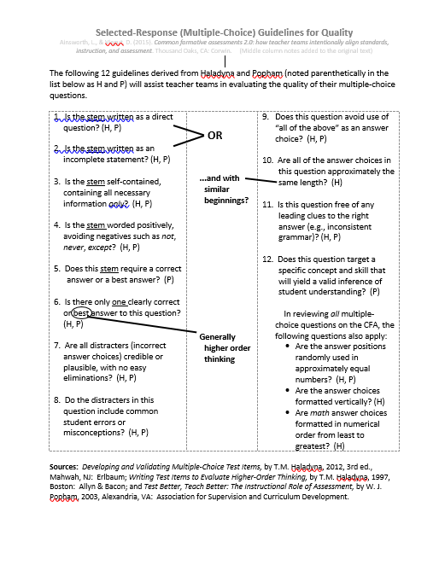
Other Considerations...
Notes:
How can I ensure the quality of multiple choice questions.?
What you can say: In addition to having quality distracters, there are a few other “rules” to writing quality multiple choice questions... The final page in your folder provides guidance. <Give participants a few moments to peruse the page, then quickly review the additional (middle column) notes.>
<Then> Select one or two of the questions that you have seen today (either from the envelopes or from the distracters page), and with a partner, compare them to this page. Where are they strong? Where do they fall short? If they don’t meet one of the guidelines, what impact might that have on the student, the assessment, and/or the inferences we could make from that data?

Slide 15
Gallery Walk -- one of each
Something I want to share with my colleagues.
Something I learned today.
Something I enjoyed about the day.
Notes:
What you can say: Post it note for each... Place them on the chart paper, then walk around again to see what others have written.

Slide 16
THANK YOU
SCD@MOBOCES.ORG
WWW.MOBOCES.ORG/BUILDINGCAPACITY

